Slide 1
What is SSH?

Slide 2
User가 Remote Computer에 접속해서 이메일을 체크하거나 특정 파일을 수정하거나 명령을 수행하고자 할 때, Login Session을 거치게 된다.
이메일이나 파일 수정과 같은 Sessions들에 들어갈 때 Shell(Shell Accounts)이라 일컬어지는 프로그램을 실행시켜야 한다.
외부 컴퓨터의 Shell에 접속하기 위한 여러가지 프로그램이 있다. Ex) Telnet

Slide 3
Telnet Security Issue
Everything you send or receive from over telnet is visible in plain text on your local network, and the local network of the machine you are connecting to.
So anyone who can “sniff” the connection in between can see your username, password, email that you read, commands that you run and their output.

Slide 4
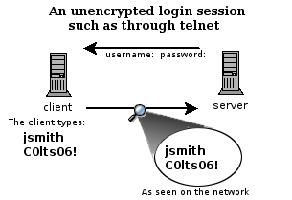

Slide 5
SSH(Secure SHell)
Alternative way of Telnet.
SSH was designed and created to provide the best security when accessing another computer remotely
Not only does it encrypt the remote session, it also provides better authentication facilities, as well as features like secure file transfer and network port forwarding.

Slide 6
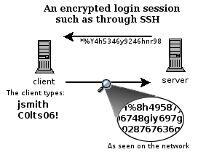

Slide 7
Getting started
One of the best and freely available clients is called PuTTY.
PuTTY can be downloaded from PuTTY

Slide 8
Accessing without a key pair

Slide 9
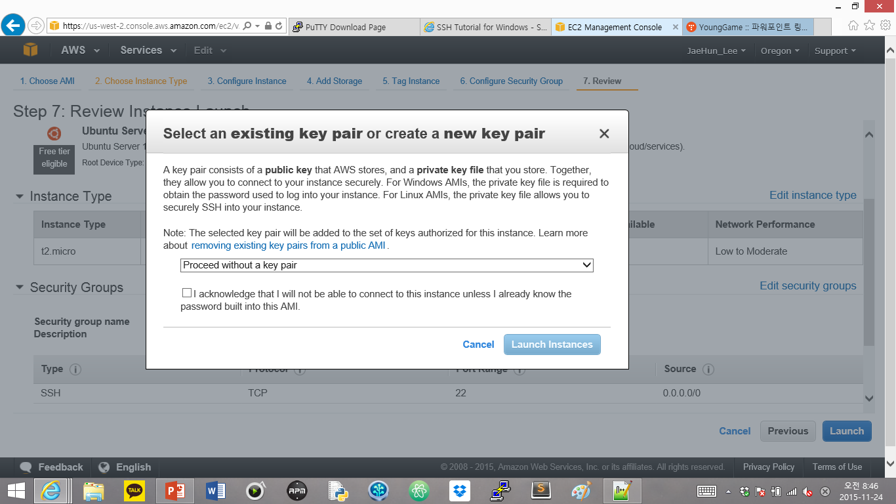

Slide 10
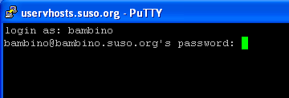

Slide 11
Accessing with a key pair

Slide 12
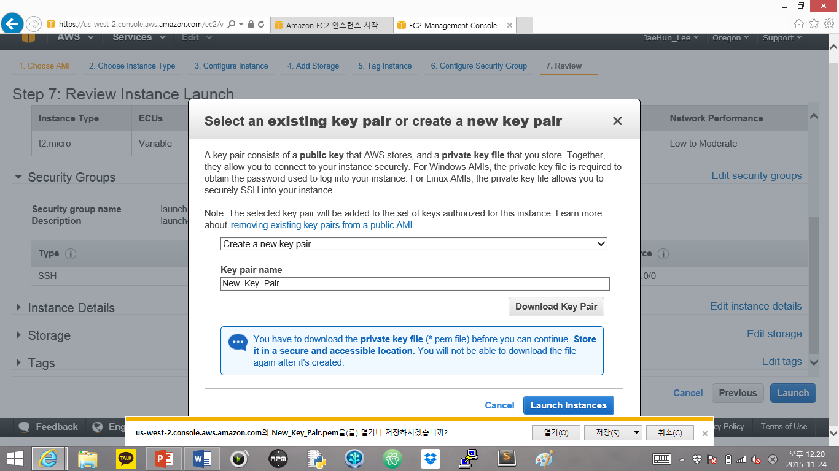

Slide 13
Generating a key.
Generate an SSH key. This key will be used to authenticate us with the server in a different way than is done when typing in a password.
PuTTYgen is a program that generates a pair of cryptographic keys used to encrypt data that you send to and from the server.

Slide 14
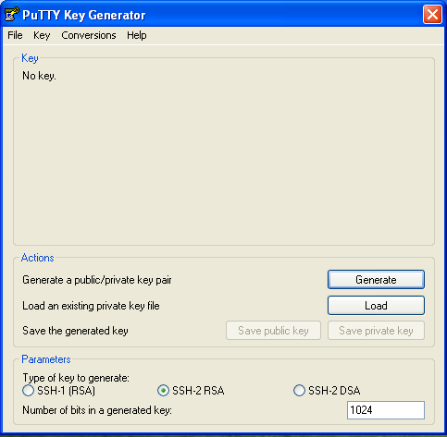

Slide 15
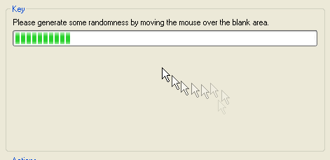

Slide 16
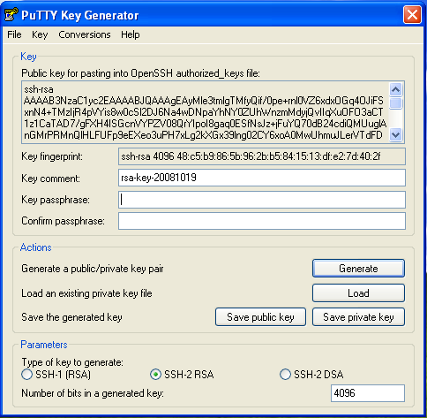

Slide 17
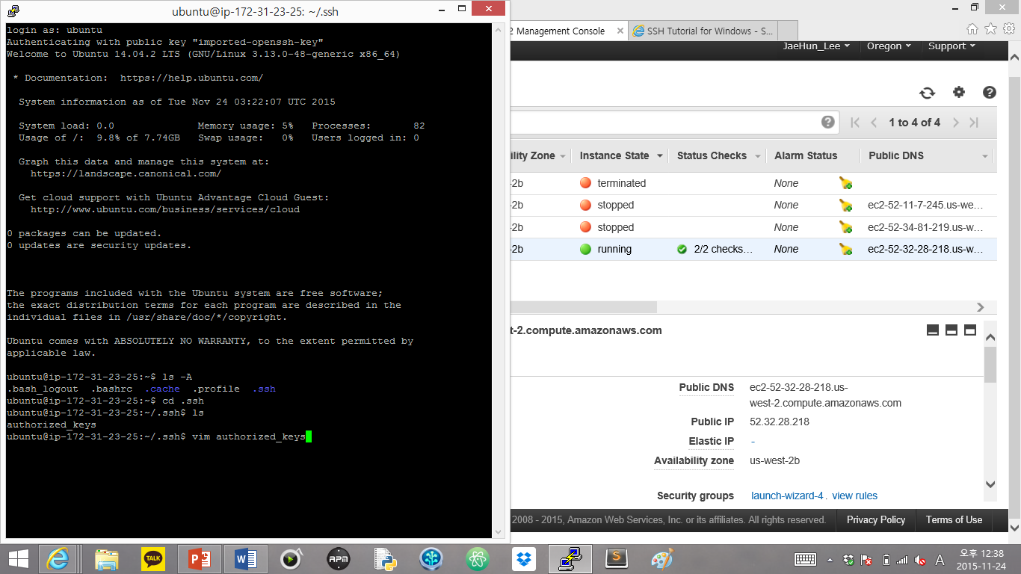

Slide 18
